Slide 1

Chapter 14
Multi-Way Search Trees

Slide 2
Chapter Scope
Examine 2-3 and 2-4 trees
Introduce the concept of a B-tree
Example specialized implementations of B-trees

Slide 3
Combining Tree Concepts
We've seen:
general trees, with multiple children per node
binary search trees, with a relationship among the elements but only two children per node
A multi-way search tree combines these elements
Each node might have more than two children with a specific relationship among the elements

Slide 4
2-3 Trees
In a 2-3 tree, each node has zero, two or three children
A 2-node contains one element, and a 3-node contains two elements
A 2-node can has either two children or no children
A 3-node has either three children or no children

Slide 5
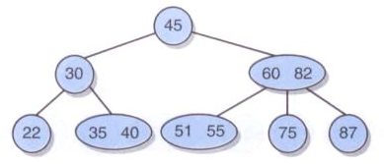
2-3 Trees
A 2-3 tree:
The relationship among the parents and children reflect the contents

Slide 6
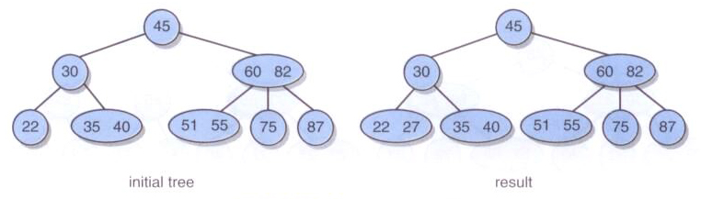
2-3 Trees
Inserting an element may simply add an element to a leaf node
Adding 27:

Slide 7
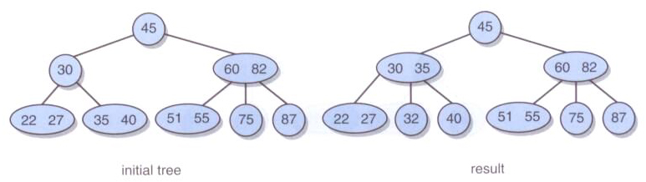
2-3 Trees
Inserting an element may split a 3-node and move an element up
Adding 32:

Slide 8
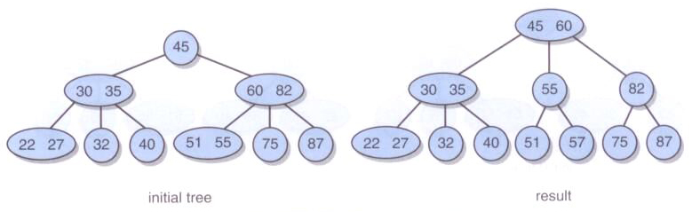
2-3 Tree
Splitting a 3-node whose parent is already a 3-node causes ripple effects
Adding 57:

Slide 9
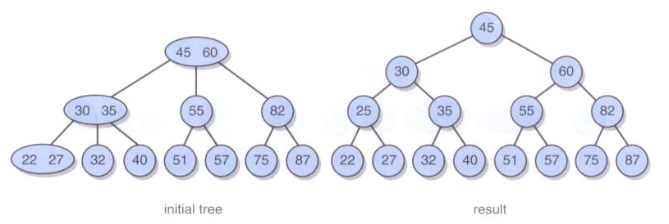
2-3 Trees
If a ripple effect propagates all the way to the root, a new 2-node is created
Adding 25:

Slide 10
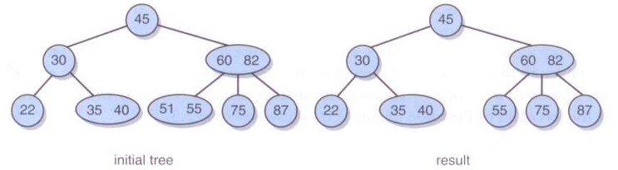
2-3 Trees
Removing an element may convert a 3-node into a 2-node
Removing 51:

Slide 11
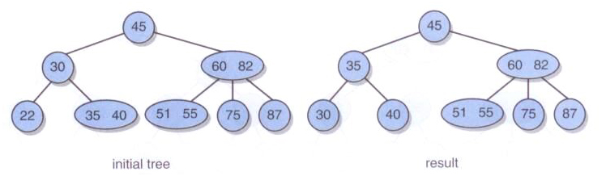
2-3 Trees
Removing a 2-node leaf causes an underflow and requires a rotation
Removing 22:

Slide 12
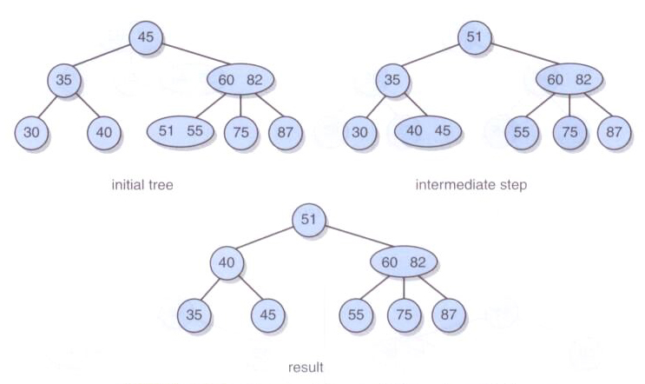
2-3 Trees
Underflows may require multiple rotations
Removing 30:

Slide 13
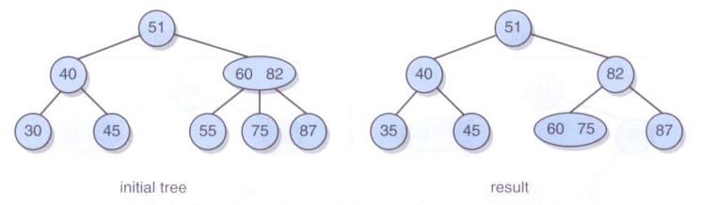
2-3 Trees
Removing 55:

Slide 14
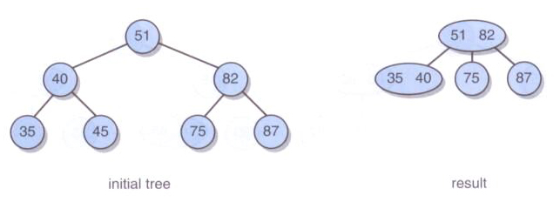
2-3 Trees
Rotations may not solve everything – the height of the tree may have to be reduced
Removing 45:

Slide 15
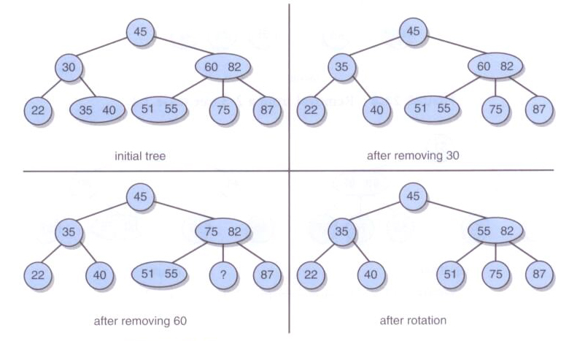
2-3 Trees
Removing internal nodes 30, then 60:

Slide 16
2-4 Trees
A 2-4 tree is similar to a 2-3 tree, with nodes that can contain three elements
A 4-node has either four children or no children
The same ordering rules apply
Similar cases govern insertions and removals

Slide 17
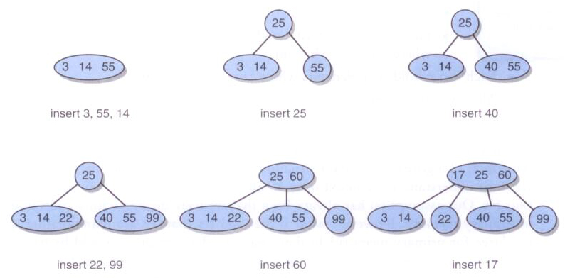
2-4 Trees
Insertions into a 2-4 tree:

Slide 18
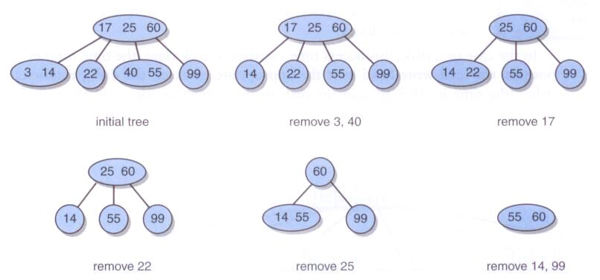
2-4 Trees
Removals from a 2-4 tree:

Slide 19
B-trees
2-3 and 2-4 trees are examples of a larger class of multi-way search trees called B-trees
The maximum number of children of each node is called the order of the B-tree
Thus, a 2-3 tree is a B-tree of order 3
A 2-4 tree is a B-tree of order 4

Slide 20
B-Trees
B-trees of order m have the following properties
The root has at least two subtrees unless it is a leaf
Each non-root internal node n holds k-1 elements and k children where [m/2] ≤ k ≤ m
Each leaf n holds k-1 elements, where [m/2] ≤ k ≤ m

Slide 21
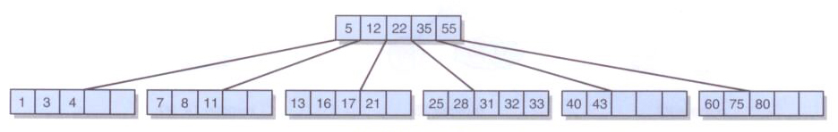
B-Trees
A B-tree of order 6:

Slide 22
Variations on B-Trees
A B*-tree is a B-tree that guarantees that each non-root node is at least two-thirds full
This avoids the problem of the B-tree being half empty
In a B⁺-tree, each element appears in a leaf, even if it also appears in an internal node
This improves the sequential access to all elements of the tree

Slide 23
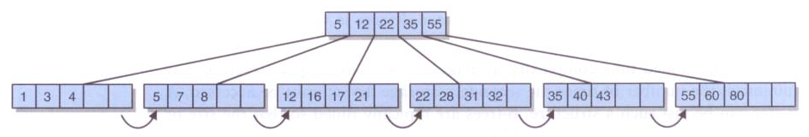
Variations on B-trees
A B⁺-tree of order 6:

